Slide 1
Common Estimation Methods
Method of Moments: This technique equates moments (like the mean or variance) calculated from the sample to the corresponding moments of the population, solving the resulting equations to estimate parameters.
Maximum Likelihood Estimation (MLE): MLE finds the parameter values that maximize the probability of observing the given sample data.
Least Squares Estimation: This method finds the parameters that minimize the sum of the squared differences between observed values and those predicted by the model.
Bayesian Estimation: This approach uses a Bayesian perspective to update prior beliefs about parameters in light of observed data, providing an estimate that incorporates both prior information and the likelihood of the data.

Slide 2
Least Squares Estimation
Least Squares Estimation: This method finds the parameters that minimize the sum of the squared differences between observed values and those predicted by the model.
Least squares estimation is a fundamental method in linear regression for finding the "line of best fit" by minimizing the sum of the squared differences (residuals) between the observed data and the model's predictions.
It is an optimization technique that provides the coefficients for a linear equation that best describe the relationship between variables in a dataset.

Slide 3
How Least Squares Estimation Works
Model Definition:
A linear regression model assumes a linear relationship between a dependent variable (y) and one or more independent variables (x), represented by a line with a certain slope and y-intercept.
2. Calculate Residuals:
For each data point, the vertical distance (the "residual" or "error") between the actual observed value and the value predicted by the current line is calculated.
3. Square the Residuals:
These differences are then squared to prevent negative and positive errors from canceling each other out and to penalize larger errors more heavily.

Slide 4
How Least Squares Estimation Works
4. Minimize the Sum:
The goal of the least squares method is to find the specific values for the model's coefficients (like the slope and intercept) that result in the smallest possible sum of these squared residuals.
5. Calculus for Solution:
This minimization is often achieved by using calculus to find the partial derivatives of the sum of squared errors with respect to the coefficients, which leads to a set of equations (normal equations) that can be solved to find the estimated coefficients.

Slide 5
Regression
Regression in supervised machine learning is a statistical method to model the relationship between a dependent (target/output) and one or more independent (predictor/input) variables
More specifically, regression helps us to understand how the value of the dependent variable is changing corresponding to an independent variable.
It predicts the continuous/real values (such as temperature, age, salary, price, etc.) of output variables.
Regression can be classified into different types based on the number of predictor variables and the nature of the relationship between variables – simple linear regression, multiple linear regression, polynomial regression, etc.

Slide 6
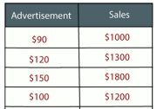
Simple linear regression
It is one of the simplest and most widely used statistical models.
Only one independent variable and it is assumed that there is a linear relationship between the independent and dependent variables.
Change in the dependent variable is proportional to the change in the independent variables.
Example: Suppose there is a marketing company A, who does various advertisement every year and get sales on that. The below list shows the advertisement made by the company in the last 5 years and the corresponding sales:

Slide 7
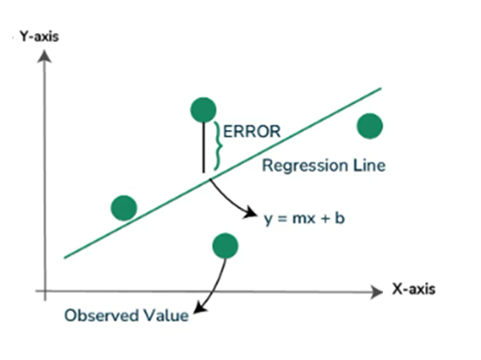
Simple linear regression
Simple linear regression in Machine Learning is a technique used to understand the relationship between one input (predictor) and output (target) variable. This way it can predict the sales for a particular advertisement cost.
In linear regression analysis, we plot a graph where we try to draw a line that best fits the data points. This line is called the regression line. The idea is to make sure the vertical distances (also called errors or residuals) between each data point and the line are as small as possible.
There are infinitely many lines that you could draw through a scatter plot of data points. But regression chooses one special line — the best-fit line - the one that minimizes the total squared error, where the error is the vertical distance between each data point and the line.
This is usually done using a method called Least Squares.

Slide 8


Simple linear regression
The least-squares method is a statistical method used to find the line of best fit of the form of an equation such as y = mx + b to the given data.
Our main objective in this method is to reduce the sum of the squares of errors as much as possible. This is the reason this method is called the least-squares method.
For just one observation,
But this is the error of a single data point; our dataset will have multiple instances, and there will be a separate error term for each instance. Therefore, we can add up all the losses and find the loss of the whole model.

Slide 9

Simple linear regression
The final error term is square of the error over all data points or observations
Now we need to differentiate the Error term with respect to the slope (m) as well as with respect to the intercept (c). And then, by equating the resulting equation to zero, we can find an expression for both slope and intercept.

Slide 10
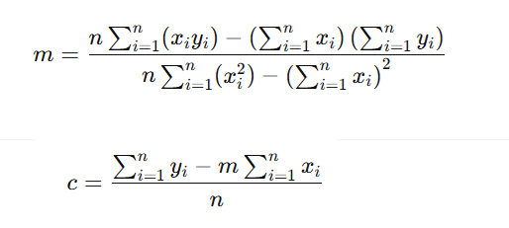
Simple linear regression
The Final output comes out as this:

Slide 11
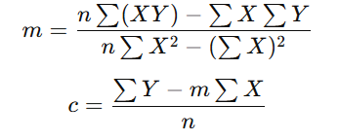
Simple linear regression
The value “m” is the Slope, and “c” is the Intercept of the regression line. By establishing these two values, we have completed our regression model.
The above is called simple linear regression because the output or dependent variable depends on only one input or independent variable

Slide 12
Simple linear regression
Real-Life Example: Predicting Salary Based on Years of Experience
Suppose you work in HR and want to predict an employee’s salary based on their years of experience.
Years of Experience (X) | Salary (in ₹ lakhs) (Y)
1 | 2.5
2 | 3.0
3 | 4.0
4 | 4.5
5 | 5.0

Slide 13
Simple linear regression
X | Y | XY | X²
1 | 2.5 | 2.5 | 1
2 | 3.0 | 6.0 | 4
3 | 4.0 | 12.0 | 9
4 | 4.5 | 18.0 | 16
5 | 5.0 | 25.0 | 25
ΣX = 15 | ΣY = 19 | ΣXY = 63.5 | ΣX² = 55

Slide 14
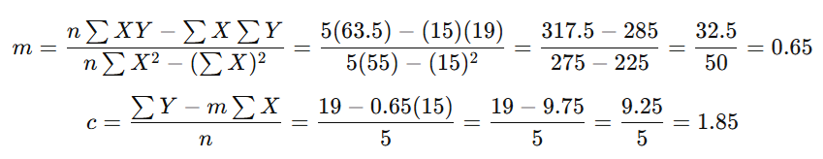
Simple linear regression

Slide 15
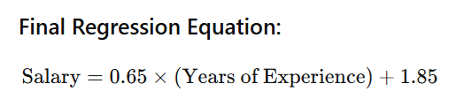
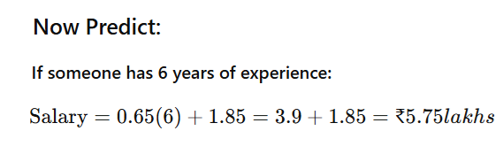
Simple linear regression

Slide 16
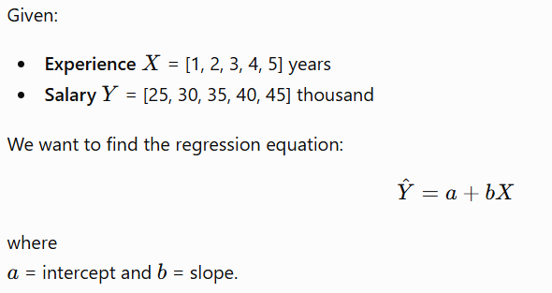
Given the following dataset, perform linear regression to predict salary based on experience:
  Experience (years): [1, 2, 3, 4, 5]
  Salary (thousands): [25, 30, 35, 40, 45]
  Find the regression equation and predict salary for 6 years of experience. Answer Hints: Calculate slope and intercept using least squares formulas, prediction, goodness of fit

Slide 17
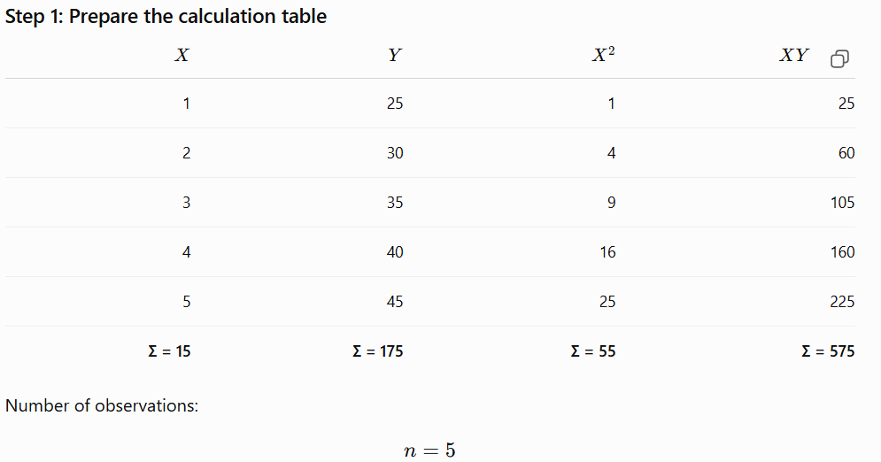

Slide 18
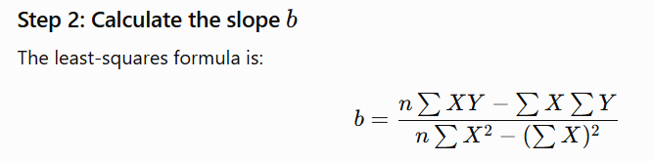
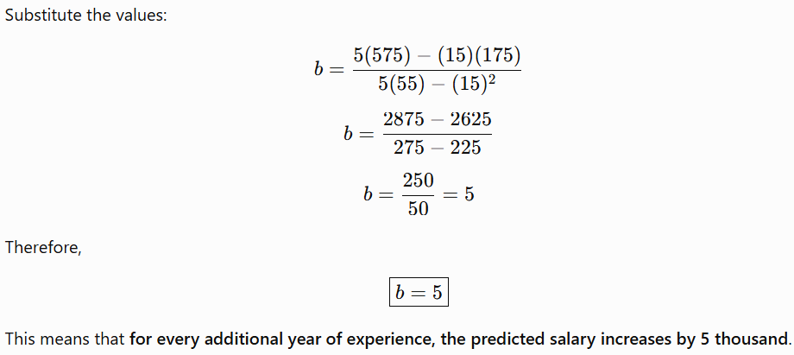

Slide 19

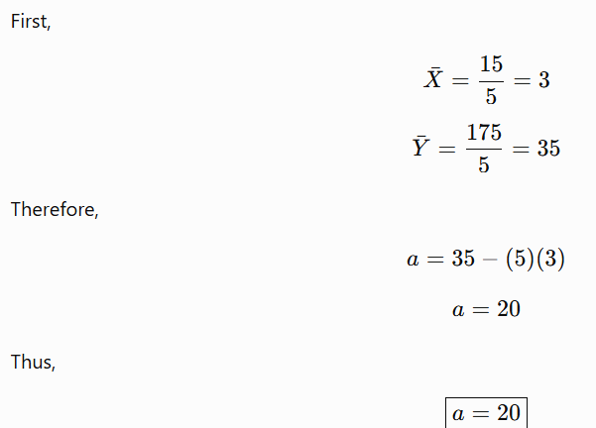

Slide 20
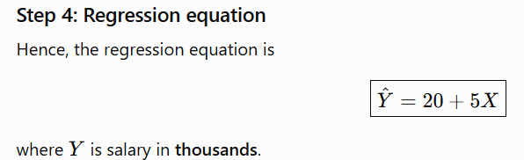
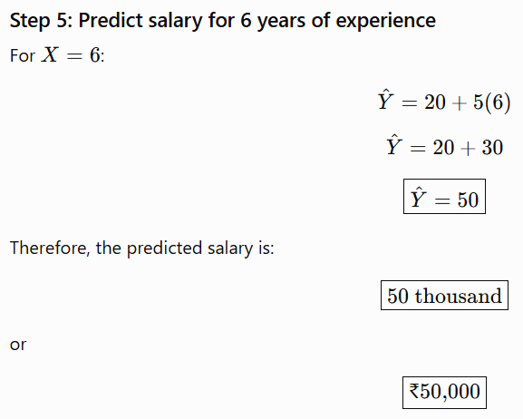

Slide 21
